Slide 1
THE US AND JAPANESE INDUSTRIAL REVOLUTIONS
The Expansion of the Global “Core” to the USA (1820-1920) and Japan (1868-1945)

Slide 2
Introduction
One of the mysteries of the modern world economy is why some countries have managed to be “upwardly mobile” within whereas others have not. Factor endowments may be part of the answer but competitive advantage in Porter’s sense is more to the point. In terms of industrialization or developing mass production manufacturing on the European model two countries stood out down until the past thirty years (with the rise of China and other East Asian “developmental states”): the United States and Japan. Yet, they are so different in many ways. So the purpose of this lecture is to describe some features of the industrialization of the pair and try to sort out what was significant for each and what, in the end, worked to both their advantages. So, there are three parts: 1. the US experience; 2. the Japan experience; and 3. what did they share that made their rapid industrialization possible even while faced by cutthroat European competition in textiles, armaments, chemicals, and so on.

Slide 3
A. USA
Two periods: I.1820-1860 -- building capacity and II. 1860-1920 – industrial power
I. 1820-1860 key words: GOVERNMENT PROTECTION & STIMULATION
1. Political independence – had been a resource economy serving Britain before 1787; 2. 1816 (“Dallas”) Tariff – encouraged import substitution, protected infant industries, particularly cotton textiles in New England; opposed by southern states – they exported raw materials; 3. Federal government – common currency (“Greenback”), limited trade barriers between states, common external tariff created economies of scale within the country as a whole: political gridlock over whether agrarian economy based on slavery and industrial economy based on free labor could co-exist in the same country.

Slide 4
4. Chronic shortage of skilled labor – major incentive for technological development
5. Dominant political ideology was “liberal” (in 19th century sense) – individualism, enterprise, country of refugees from religious and political persecution, no history of feudalism – “born modern” (Louis Hartz). Of course “the South” stood apart as an economy based on plantation slavery and the export of raw materials. Its ideology was racist, reactionary, and illiberal.

Slide 5
II. 1860-1920 key words: TRUSTS and IMMIGRATION
1. Northern victory in US Civil War. The South’s economy was based on plantation slavery and exporting raw materials to Europe (cotton, tobacco, etc.). So, it was antithetical to developing domestic industry on two grounds: hostility to protectionist tariffs to favor US manufactures and slavery as opposed to the free wage labor on which factory work was based.
2. Emergence of very large firms (“Trusts”): M&A and the Robber barons – Carnegie, Rockefeller, Vanderbilt, Stanford, etc. Sherman Anti-Trust Act of 1890 but apart from breaking up Standard Oil not really implemented.

Slide 6
Reason for concentration of ownership of entire sectors (railroads, steel, oil, etc.): economies of scale at firm NOT just plant level and high costs of R&D in an economy where capital substituted for labor.
3. Investment banks and stock markets: speculative finance/futures – risk-taking plus future orientation: new forms/sectors.

Slide 7
4. Massive immigration 1870-1920, primarily from Europe: suppressed wages of unskilled.
5. Emergence of the US manufacturing belt: Boston to Chicago – immigrant waves, labor organizing, and by 1910, crisis in mass production (Figures 1 and 2).

Slide 8
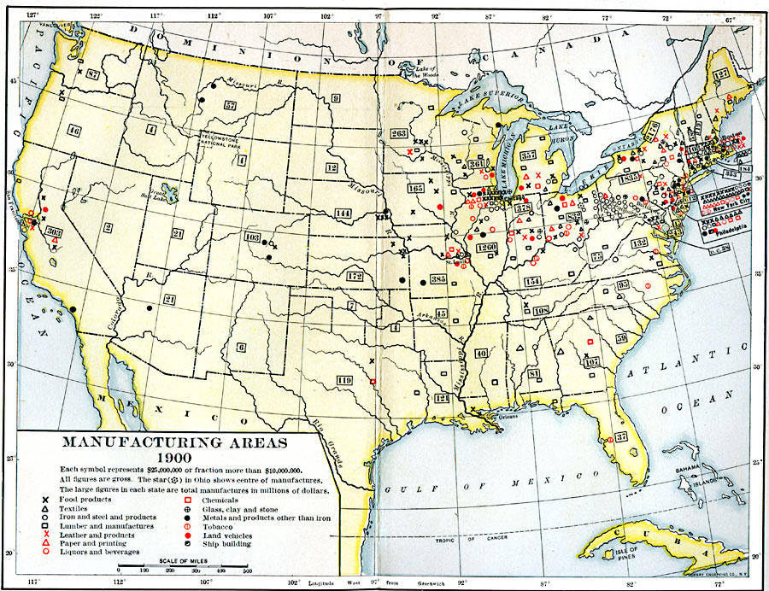
Figure 1

Slide 9
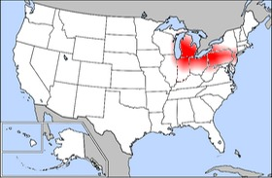
Figure 2

Slide 10
B. JAPAN
I. 1605-1868 key words: ISOLATION and CENTRALIZATION
After early colonial incursions by Portuguese and Dutch during Japan’s civil war period, once central rule from Edo (Tokyo) re-established foreigners restricted.
In the 1850s isolation challenged by US and others. After 1868, systematic attempt by Japan’s government to industrialize to meet foreign challenge (so-called Meiji Restoration). Limited resource base.

Slide 11
II. Two periods of industrialization: 1868-1919 and 1919-1945: EMPIRE and MILITARIZATION
1868-1919: government at center of development of new industries but after 1895 these are run privately through giant firms (Zaibatsu) – Mitsubishi, Mitsui, Sumitomo, Yasuda (Figure 1). Japanese colonialism in Korea. Wars with China and Russia. Resources in Manchuria and northern Korea as the main attractions.

Slide 12
1919-1945: imperial policy: expand in East and SE Asia to acquire resources to fuel industries and find markets for sales and investment because closed out elsewhere by US and European colonial powers. (Figure 2). Active industrial policy favoring armaments industries. Tokyo and Osaka as the two main centers on south coast of Honshu (Figure 3)
After defeat by US and allies in 1945 and US Occupation: export-oriented industrialization. Zaibatsu dismantled but still large firms dominant (Toyota, Nissan, etc.). Role of MITI. In the 1970s: rise of Japanese FDI in US and Europe.

Slide 13
Figure 1: The Main Zaibatsu (late 1800s until US Occupation of Japan 1945-1950)
“The Big Four”
Mitsubishi (三菱財閥)
Mitsui (三井財閥)
Sumitomo (住友財閥)
Yasuda (安田財閥)

Slide 14
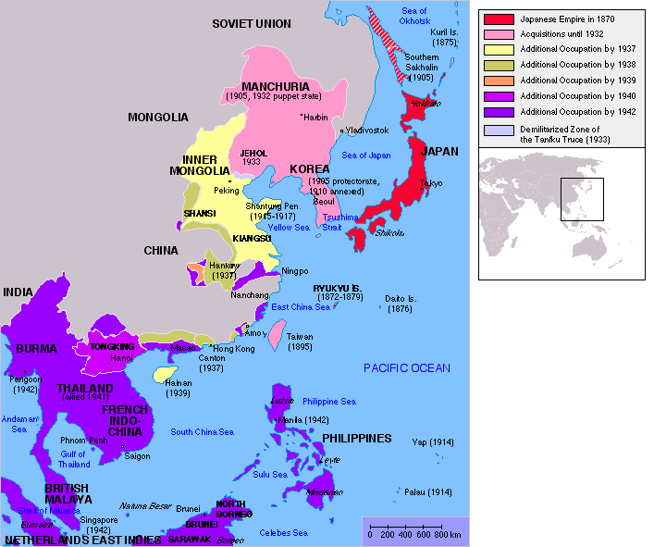
Figure 2: Japan’s efforts at empire

Slide 15
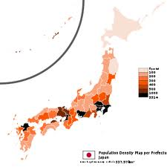
Figure 3: Population Density

Slide 16
C. CONCLUSIONS
What set them apart:
1. Political independence
2. Strong central government
3. Mix of redistribution and market exchange-- (protect infant industries, invest in infrastructure, invest in population/ “human capital”)
4. Organize for competitive advantage (through R&D, military spending (particularly in Japan), land grants, tax subsidies, etc.)

